Slide 1
Cardio-vascular 2:
PT7001 + PT4054
February 2025
c.chamberlin@londonmet.ac.uk

Slide 2
learning outcomes:
  Regulation of cardiac output
    Filling pressure and central venous pressure
    Neural control of heart rate and contractility
    The basic electrocardiogram
  Fluid transfer across capillary walls
  Control of blood pressure
    Baroreceptor reflex
    Blood volume

Slide 3
1. Regulation of cardiac output

Slide 4
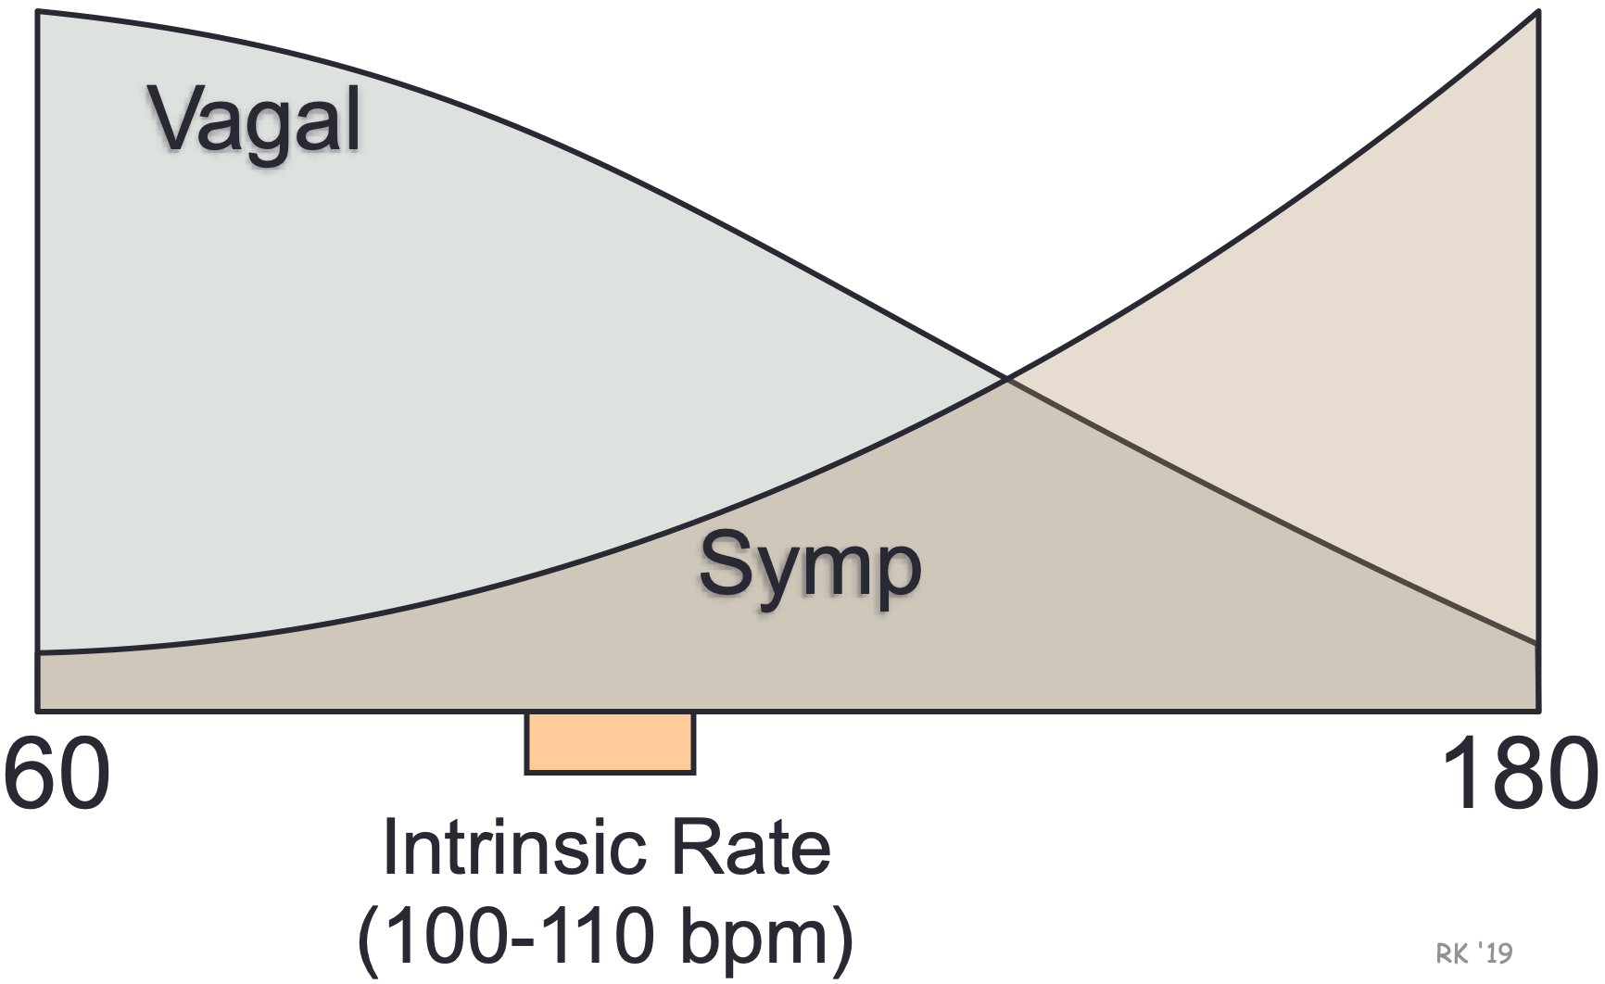
Affects of parasympathetic stimulation

Slide 5
Affects of parasympathetic stimulation
Mediated by release of acetylcholine (ACh), causing reduction in heart rate via the Sinus node
Cardiac muscarinic (acetylcholine) M2 receptors located in the heart reduce atrial force but little impact on the ventricular force
The local signalling compound nitric oxide (NO), increases the amount of Ach released in response to each vagal action potential
Notes:
Vagus nerve interfaces with the parasympathetic control of the heart.

Slide 6
Affects of sympathetic stimulation
Mediated by release of noradrenaline, causing:
  Increased heart rate
  Increased AV node conduction velocity
  Shortening of myocyte action potential
  Increased contractile force
  Quicker relaxation
Thus sympathetic stimulation not only increases heart rate, but also shortens components of the cardiac cycle

Slide 7
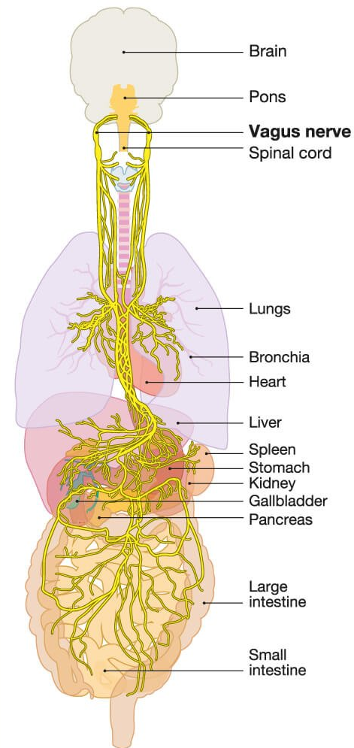
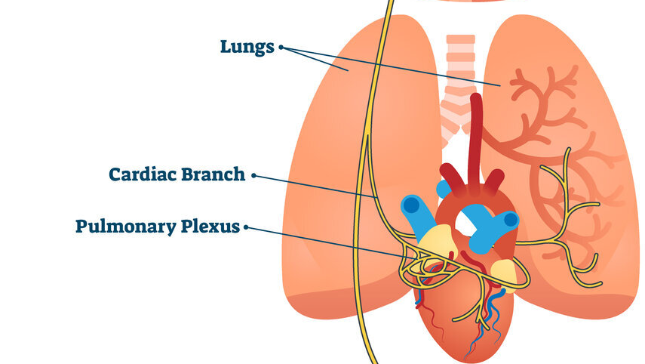
Vagus nerve

Slide 8
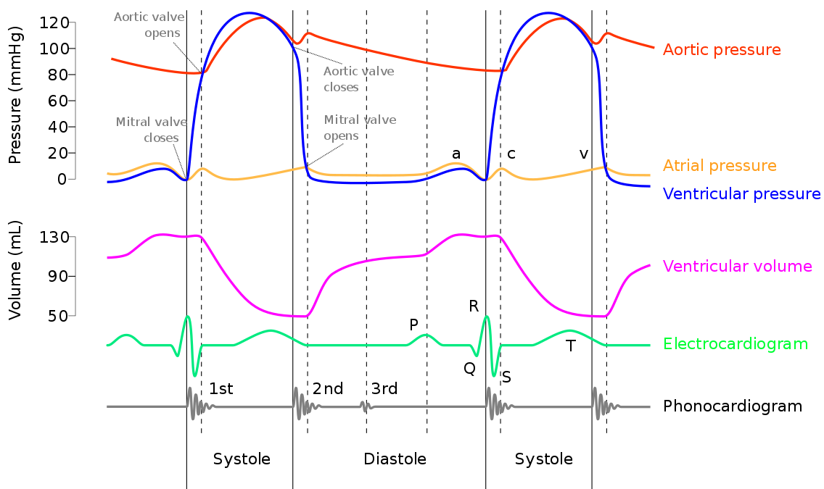
Cardiac cycle-Wiggers diagram

Slide 9
Factors influencing
Central Venous Pressure
CVP = blood pressure in the vena cava (the blood returning to the heart)
Notes:
Vena cava carries deoxygenated blood to the right side of the heart.

Slide 10
Factors influencing
Central Venous Pressure
Gravity/posture
  Compared with lying down, standing redistributes about 500 ml of blood from the thorax to the lower limbs, due to the effect of gravity and the distensibility of the leg veins
  This lowers CVP and reduces SV from about 100 to 70 ml.
Notes:
Vena cava carries deoxygenated blood to the right side of the heart.

Slide 11

Factors influencing
Central Venous Pressure
  Cutaneous vasodilation (for example during hot weather) reduces CVP and Q and can lead to fainting.

Slide 12
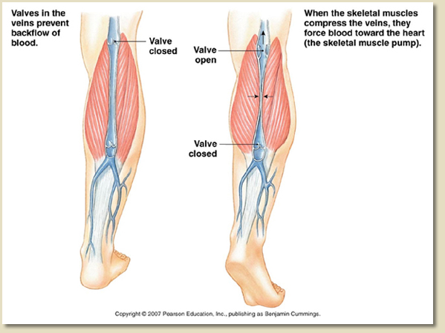
Factors influencing
Central Venous Pressure
Venous muscle pump
  One way valves in the veins ensure that blood is squeezed back towards the heart, increasing CVP

Slide 13
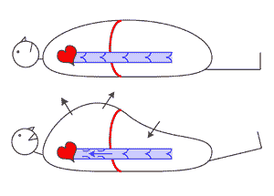
Factors influencing
Central Venous Pressure
Respiratory pump
  Inhalation increases the flow of blood into the thorax, thus increasing CVP and producing an increase in right ventricular stroke volume

Slide 14
Factors influencing
Central Venous Pressure
Respiratory pump
  Exhalation causes lower right ventricular SV and higher left ventricular SV.
    Inspiration: increased SV from the right side
    Expiration: increased SV from left side

Slide 15
Stroke volume and its control
Stroke volume at rest is 70-80 ml
This will increase to about 100ml in heavy exercise, or 120 ml in trained subjects
Olympic athletes may have stroke volumes of 160 ml
Cardiac output is determined by heart rate and stroke volume, both of which contribute to increased cardiac output during exercise:
CO = HR x SV
Training effects are primarily confined to stroke volume

Slide 16
Stroke volume
Stroke volume is equal to the amount of blood pumped from the left ventricle in a single cardiac contraction
It is equal to the end-diastolic volume (EDV) minus the end-systolic volume (ESV)
Typical resting values for these two variables are 120 and 50 ml respectively
Note that the ESV in the heart is not zero: there is a substantial volume of blood left in the ventricle at the end of systole

Slide 17
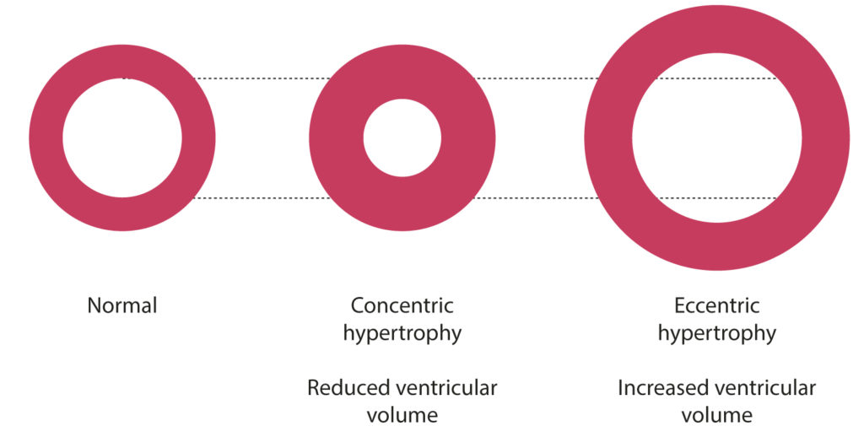
Structural changes

Slide 18
Stroke volume
Energy of contraction in the ventricle can be increased by two mechanisms:
  Raising EDV stretches the myocytes further. This has the effect of increasing energy of contraction, and is referred to as Starling’s law of the heart

Slide 19
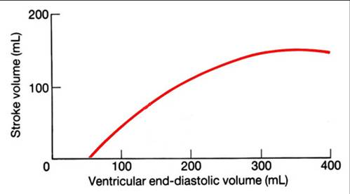
Starling’s law of the heart
The graph shows how reduced EDV is associated with reduced energy of contraction, resulting in lower stroke volume
A normal resting EDV is about 120 ml
The most important factor determining EDV is the central venous pressure.

Slide 20
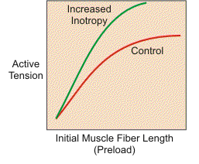
Increased contractility
Contractility influenced by extrinsic neuro-endocrine factors: sympathetic
neurotransmitter noradrenaline and the hormone adrenaline
The stronger the sympathetic activity, the steeper the green line.
Contractility = energy of contraction from a fixed EDV
Cardiac function curve

Slide 21
What determines EDV?
The immediate non-cardiac factor determining EDV is the “central venous pressure” (CVP). This is the blood pressure at the entrance to the right atrium
→ ↑right atrial filling
→ ↑ right ventricle filling
→ ↑right ventricle stroke volume*
→ ↑left atrial filling pressure
→ ↑left atrial filling
→ ↑ left ventricle filling
→ ↑ left ventricle stroke volume*
*Starling effect

Slide 22
EFFECT OF BED-REST / TRAINING ON CARDIAC OUTPUT
Saltin et al., Circulation. 1968
Changes at maximal exercise only
25
Control
◻ after 20d of bed rest
Ο after 50d of training
20
Cardiac output (l/min)
15
10
5
1 2 3 4
Oxygen uptake (l/min)

Slide 23
Effect of bed rest / training on stroke volume & heart rate
Saltin et al., Circulation. 1968
100
200
Heart rate (bpm)
Stroke volume (l/min)
50
100
1 2 3 4
1 2 3 4
Oxygen uptake (l/min)
Oxygen uptake (l/min)
Δ Control; ◻ after 20d of bed rest; Ο after 50d of training

Slide 24
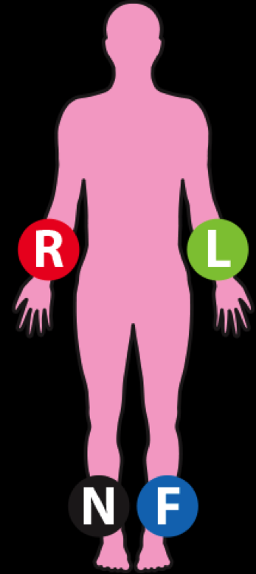
Carrying out an ECG
Placement of the Limb Leads
Only 10 leads and electrodes used in a 12 lead ECG.
R, L, F all talk to each other in order to calculate the cardiac axis.
N= neutral lead
Incorrect placement = incorrect reading

Slide 25
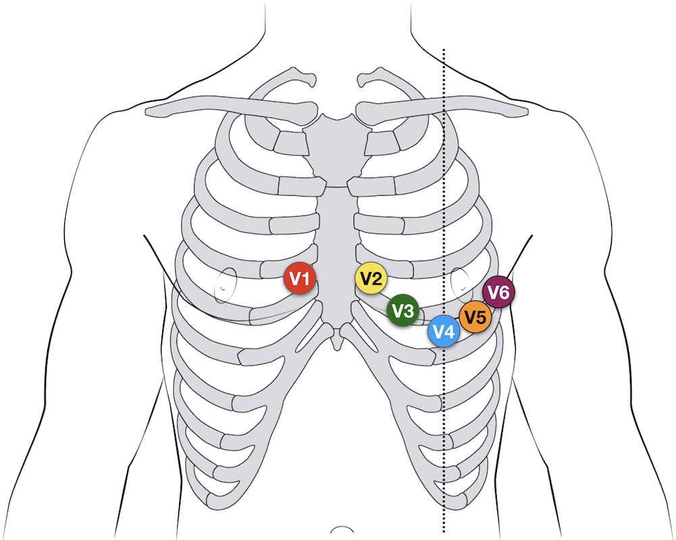
Carrying out an ECG
Placement of chest electrodes
Correct placement is paramount!
1st electrode is placed in the 4th intercostal space on the right of the chest.
6th electrode is placed in the 5th intercostal space under the left arm pit
Horizontal plane

Slide 26
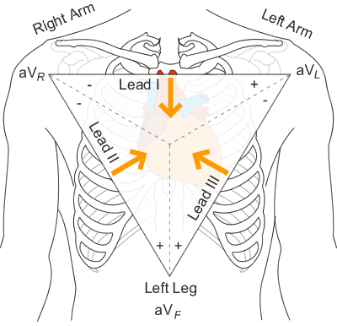
Carrying out an ECG
I, II, III, aVR, aVL, and aVF
Vertical plane

Slide 27
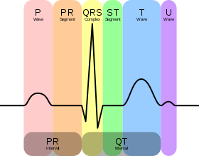
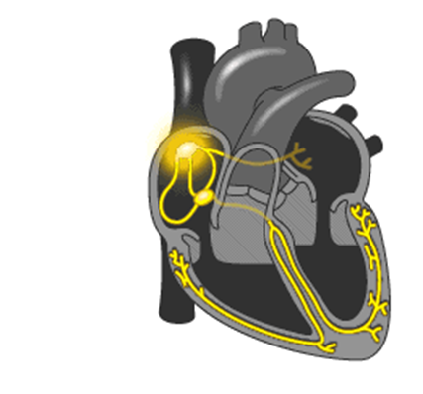
What does it all mean?
The rhythm represents the depolarisation and repolarisation stages of a heart beat.

Slide 28
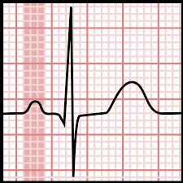
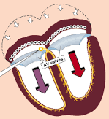
P wave
The P wave represents atrial depolarisation.
SA node has started an action potential, causing the atriums to contract.

Slide 29
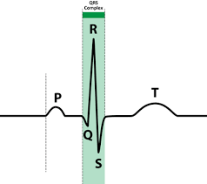
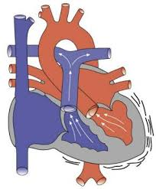
QRS Complex
The QRS complex phase represents ventricular depolarisation and atrial repolarisation.
Ventricular contractions supply the body with the amount of blood required to sufficiently perfuse the bodies cells.

Slide 30
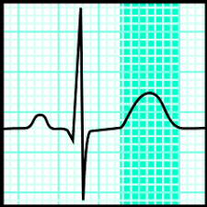
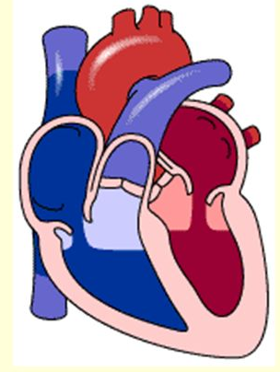
T Wave
The T wave represents the repolarisation of the ventricles.

Slide 31
Practical Application
Used alongside other tests to diagnose cardiac conditions.
Used to monitor conditions, symptoms or medications.
Chest pain
Palpitations
Dizziness
Shortness of breath

Slide 32
Practical Application
ECG can help detect:
Arrhythmias- heart beats too slowly, quickly or irregularly
Coronary heart disease- Hearts blood supply is blocked or interrupted by a build-up of fatty substances
Cardiomyopathies- Heart walls can become thickened, dilated or have genetic abnormalities

Slide 33
Practical Application
The type of ECG is dependent on symptoms or suspected problem.
Resting ECG – lying down
Exercise ECG – on an exercise bike or treadmill
Ambulatory ECG – electrodes are connected to a small portable machine so the cardiac rhythm can be monitored at home for a set number of hours.

Slide 34
2. Fluid transfer across capillary walls
Hydrostatic pressure = Pressure exerted by a fluid due to the force of gravity
Oncotic pressure = osmotic pressure exerted by colloids
in a solution; majority pressure exerted by Albumin

Slide 35
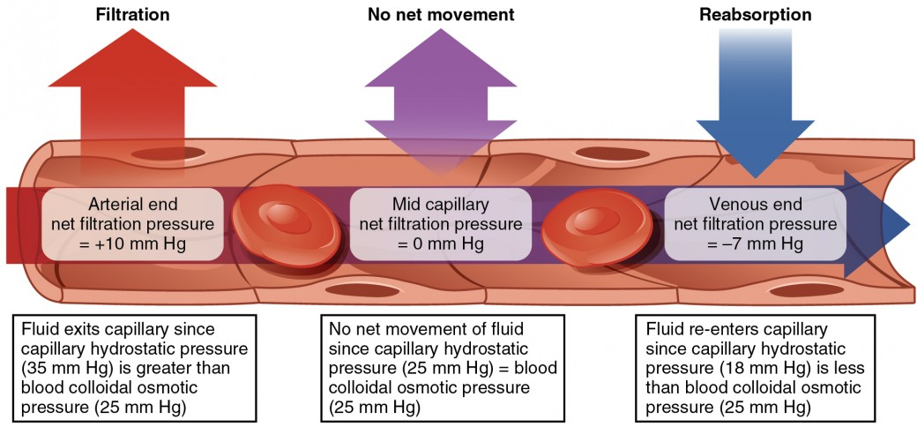
2. Fluid transfer across capillary walls

Slide 36
Force of gravity from arterial to venous

Slide 37
3. Control of blood pressure

Slide 38
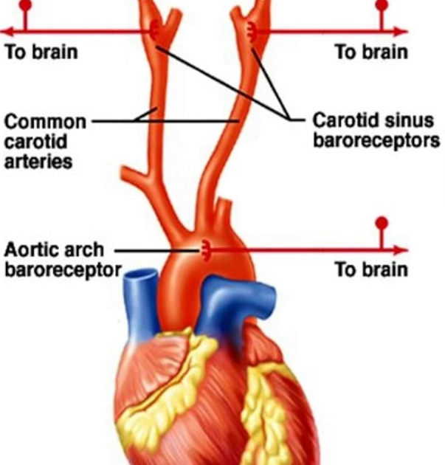
Baroreceptor reflex
Notes:
Aortic arch + Carotid sinuses (major site of pressure measurement.

Slide 39
Baroreceptor reflex
Associated wit homeostasis of blood pressure through a negative feedback loop:
Increased blood pressure = decreased heart rate
Baroreceptors sense arterial wall tension and can promote a response within one cardiac cycle (such as in regulating postural hypotension).

Slide 40
Blood volume
Approximately 60% plasma therefore reduction in volume can be the result of plasma or red cell losses.
Reduce blood volume leading to
  Collapsed vessels
  Reduced blood pressure
  Reduced perfusion pressure

Slide 41
Blood volume
Vasocontriction due to low blood volume can causing ischaemia.
Sufficient volume maintains osmolality and altered Sodium or plasma content impacts cellular function.

